Slide 1


FRONT END ENGINEERING-1​
PROJECT​
​
Team Members:​
HARSHIKA (2310990599)​
HARSHITA (2310990601)​
HARSHITA KHANDELWAL (2310990602)​
​
Faculty Coordinator:​
MS. RAJWINDER KAUR​
​
Chitkara University Institute of Engineering and Technology,​
Chitkara University, Punjab​
​

Slide 2
DO YOU OFTEN FEEL OVERWHELMED BY THE AMOUNT OF WORK YOU HAVE TO DO?

Slide 3
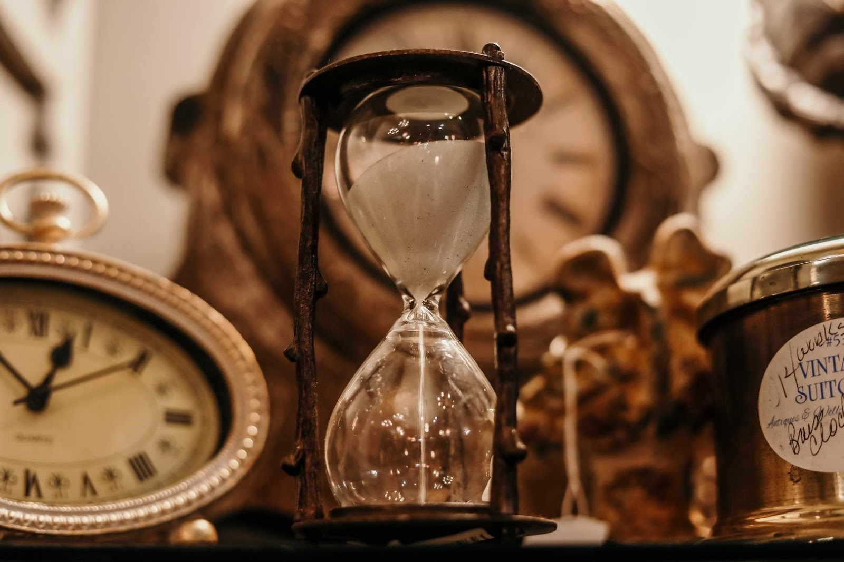
Do you find yourself
Missing deadlines ?
This Photo by Unknown Author is licensed under CC BY-NC

Slide 4

TO DO LIST…
Helps you to stay organized

Slide 5

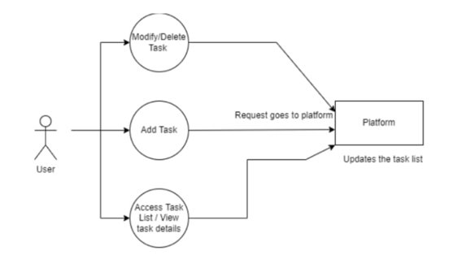
GRAPHICAL ABSTRACT​

Slide 6
TABLE OF CONTENT​
JSR.NO | TOPIC | SLIDE NO
1 | Introduction | 1
2 | Problem Statement | 2
3 | Technical Details | 3
4 | Key Features | 4
5 | Advantages | 5
6 | Project images | 6
7 | Conclusion | 7
8 | Reference | 8

Slide 7
introduction
A TO-DO LIST IS A SIMPLE WEB PAGE ELEMENT THAT ALLOWS USERS TO INPUT AND MANAGE A LIST OF EXERCISE FOR PRACTICING HTML AND CSS SKILLS. A TO-DO LIST CREATED USING ONLY HTML, CSS. THIS APPROACH RESULT IN A LIGHTWEIGHT AND FAST-LOADING WEB PAGE ELEMENT THAT CAN BE EASILY STYLED TO MATCH ANY WEBSITE OR APPLICATION DESIGN.
WITH THE HELP OF TO-DO LIST, WE CAN ADD A LIST OF TASKS THAT WE NEED TO GET DONE IN THE FUTURE. TRADITIONALLY, THEY WERE WRITTEN ON PAPER OR SLOG. TODAY, HOWEVER, PEOPLE ARE USING TECHNOLOGY TO QUICKLY NOTE DOWN THEIR IMPORTANT TASKS TO SET REMINDERS FOR THE UPCOMING TIME.

Slide 8
Problem statement
INFORMATION OVERLOAD​
DISORGANIZED WORKFLOWS​
TEAM COLLABORATION CHALLENGES​
INEFFECTIVE TIME MANAGEMENT​
ACCOUNTABILITY ISSUES​

Slide 9
TECHNICAL DETAILS​
​
DESIGN INTERFACE : CREATING A USER-FRIENDLY INTERFACE WITH HTML AND CSS ,PROVIDING A TO-DO LIST.​
RESPONSIVENESS : ENSURES THAT THE INTERFACE DESIGN IS RESPONSIVE TO ACCOMMODATE DIFFERENT SCREEN SIZES.​
USER INTERFERENCE: HTML AND CSS
JAVASCRIPT: USED JAVA SCRIPT TO MAKE THE PAGE MORE USER FRIENDLY AND RESPONSIVE

Slide 10
KEY FEATURES​
TASK CATEGORIES​
PRIORITY LEVELS​
DUE DATES​
STATUS TRACKING​
NOTES AND COMMENTS​
PROGRESS TRACKING​

Slide 11
ADVANTAGES​
ENHANCED PRODUCTIVITY ​
EFFECTIVE ORGANIZATION​
MEETING DEADLINES​
TEAM COLLABORATION​
TIME MANAGEMENT STRESS REDUCTION​
ACCOUNTABILITY​
IMPROVES YOUR MEMORY​
HELPS WITH MOTIVATION​

Slide 13
CONCLUSION​
THIS PROJECT HELPED US TO LEARN THE CORRECT USE OF HTML AND CSS.​
IN CONCLUSION, THE TO-DO LIST PROJECT REPRESENTS A HOLISTIC APPROACH TO TASK MANAGEMENT, ENCOMPASSING A WIDE RANGE OF FEATURES AND BENEFITS.​
BY IMPLEMENTING THIS PROJECT, USERS CAN REGAIN CONTROL OVER THEIR TASKS, REDUCE STRESS, AND IMPROVE OVERALL PRODUCTIVITY.​

Slide 14
REFERENCES ​
THE FOLLOWING REFERENCES WERE USED IN THE DEVELOPMENT OF THIS PROJECT TO-DO LIST: ​
TECH VIDVAN: https://techvidvan.com/tutorials/python-to ​
PROJECT MANAGER: www.projectmanager.com/template ​
GATE HUB: https://gatehub.net ​

Slide 15


